Slide 1

Virtual DeskTop Assistant using Python
Tools and Techniques Laboratory
KIIT University, Bhubaneswar
Guided by:-
Dr. Debajyoty Banik
Mr. Deepak Das
Ms. Sthitapragyan Pradhan
Team Members:
Prateek Agarwal - 1905814
Aryan Dubey - 1905815
Anirban Pal - 1905816
Udit Shaw - 1905817

Slide 2
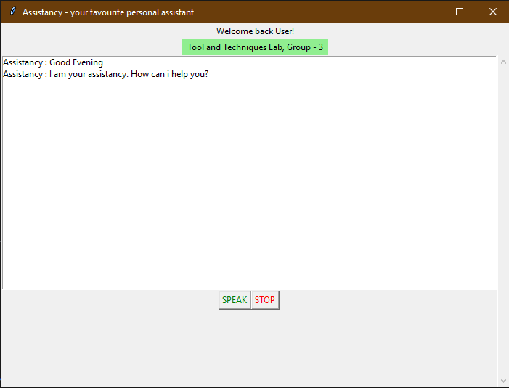
Introduction
A virtual assistant is an intelligent application that can perform tasks or provide services for a person responding to orders or inquiries.
Some VAs can understand and respond to human speech using synthesized voices.
Users may use voice commands to request their VA to answer the questions, manage home appliances, etc.

Slide 3
Overview
This is a voice-enabled Desktop assistant project using which we can automate many of our daily tasks through Speech and Voice modulation which intern uses Artificial Intelligence to answer users questions.
Using this python project, we can open various softwares on our computer, play music and videos, get daily news, live cricket scores, get date and time, get information from wikipedia, send email to contacts, make notes and perform various fun filed tasks using AI from Wolfram-Alpha API.

Slide 4
Overview
Python modules used in the Project
Datetime
Pyttsx3
Subprocess
Speech_recognitiin
Wikipedia
Webbrowser
OS
Sys
Pyjokes
Wolframalpha
SMTP (email)

Slide 5
Libraries
Subprocess - The subprocess module present in python is used to run new applications or programs through python code by creating new processes. It also helps to obtain the input/output/error pipes as well as the exit codes of various commands.
Time - Python time module allows to work with time in python. It allows functionality like getting the current time, pausing the program from executing, etc.
Pyttsx3 - pyttsx3 is a text-to-speech conversion library in python. Unlike alternative libraries, it works offline. An application invokes the pyttsx3.init() factory function to get a reference to a pyttsx3. Engine instance, it is a very easy to use tool which converts the entered text into speech.
pip install pyttsx3

Slide 6
Libraries
Datetime - Python Datetime module supplies classes to work with date and time. These classes provide a number of functions to deal with dates, times and time intervals. Date and datetime are an object in Python.
Webbrowser - Webbrowser module is a convenient web browser controller. It provides a high-level interface that allows displaying Web-based documents to users. Webbrowser can also be used as a CLI tool. It accepts a URL as the argument with the following optional parameters: -n opens the URL in a new browser window, if possible, and -t opens the URL in a new browser tab.
Wikipedia - Wikipedia is a multilingual online encyclopedia created and maintained as an open collaboration project by a community of volunteer editors using a wiki-based editing system.
pip install wikipedia

Slide 7
Libraries
OS - The OS module in Python provides functions for interacting with the operating system. OS comes under Python’s standard utility modules. This module provides a portable way of using operating system-dependent functionality. The *os* and *os.path* modules include many functions to interact with the file system.
SMTPlib - The smtplib module defines an SMTP client session object that can be used to send email to any internet machine with an SMTP or ESMTP listener daemon.
Speech_recognition - Speech Recognition is an important feature in several applications used such as home automation, artificial intelligence, etc. It plays an important role in the Speech to text translation. This is done with the help of Google Speech Recognition.
pip install SpeechRecognition

Slide 8
Libraries
Sys - The sys module in Python provides various functions and variables that are used to manipulate different parts of the Python runtime environment. It allows operating on the interpreter as it provides access to the variables and functions that interact strongly with the interpreter.
Pyjokes - Python supports creation of random jokes using one of its libraries.
pip install pyjokes
Wolframalpha - The Wolfram|Alpha Webservice API provides a web-based API allowing the computational and presentation capabilities of Wolfram|Alpha to be integrated into web, mobile, desktop, and enterprise applications. Wolfram Alpha is an API which can compute expert-level answers using Wolfram’s algorithms, knowledgebase and AI technology. It is made possible by the Wolfram Language.
pip install wolframalpha

Slide 9
Functions / Features
Speak(audio) - This function is used to speak and print the command which is generated by the program prints in return of the voice entered by the user. It also inserts the text into the ListBox and updates it.
wishMe() - This function is used to greet the user as soon as the program starts in which it interprets the time from the system/local machine and then greets appropriately depending on the time of the day.
takeCommand - This function takes the voice input from the microphone as command and analyzes it. It then gives the result of the command accordingly by activating another function or printing the command in text format.
Date - This function takes the current date from the local machine and gives the output in audio format telling the date and the day.
Note - This function opens the notepad of the system and then takes all the voice input from the microphone and converts it to text and keeps it as a note.

Slide 10
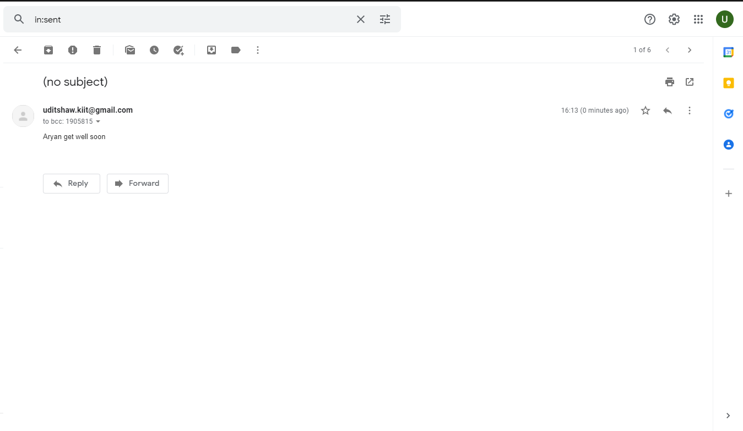
Sending Email
This is done possible with the SMTPlib library of python.
Simple Mail Transfer Protocol (SMTP) is a protocol, which handles sending email and routing e-mail between mail servers.
Python provides smtplib module, which defines an SMTP client session object that can be used to send mail to any Internet machine with an SMTP or ESMTP listener daemon.
Basic syntax:
import smtplib
smtpObj = smtplib.SMTP( [host [, port [, local_hostname]]] )

Slide 11
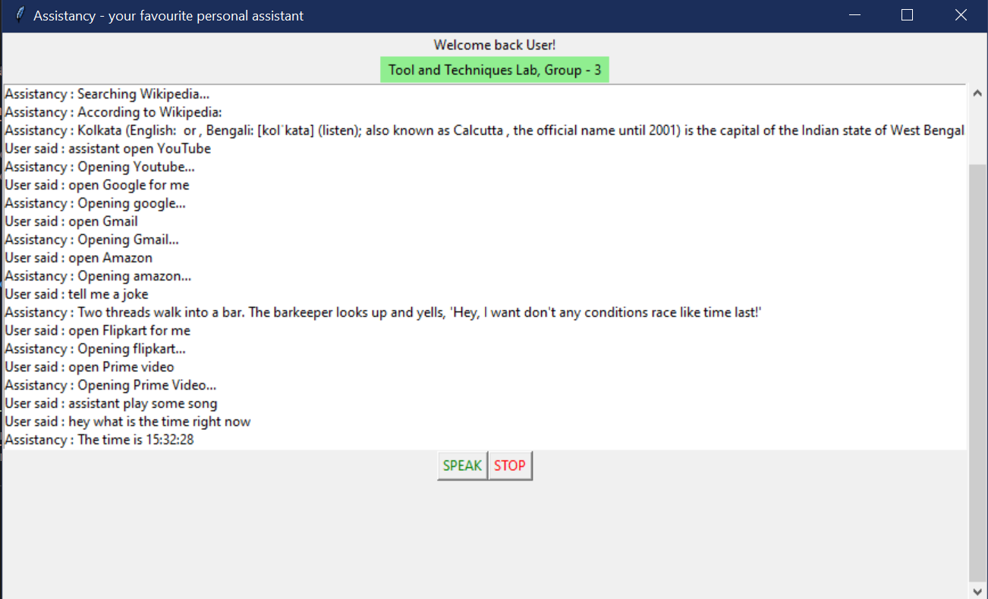
Last but not the least….
Graphical User Interface
The Graphical user interface (GUI) is made with python using the tKinter module of python.
What is tKinter?
It is a standard Python interface to the Tk GUI toolkit shipped with Python. Python with tkinter is the fastest and easiest way to create the GUI applications.
Added widgets such as Title, Label, Listbox, Scroll bar and Buttons in our project.

Slide 12


